Slide 1

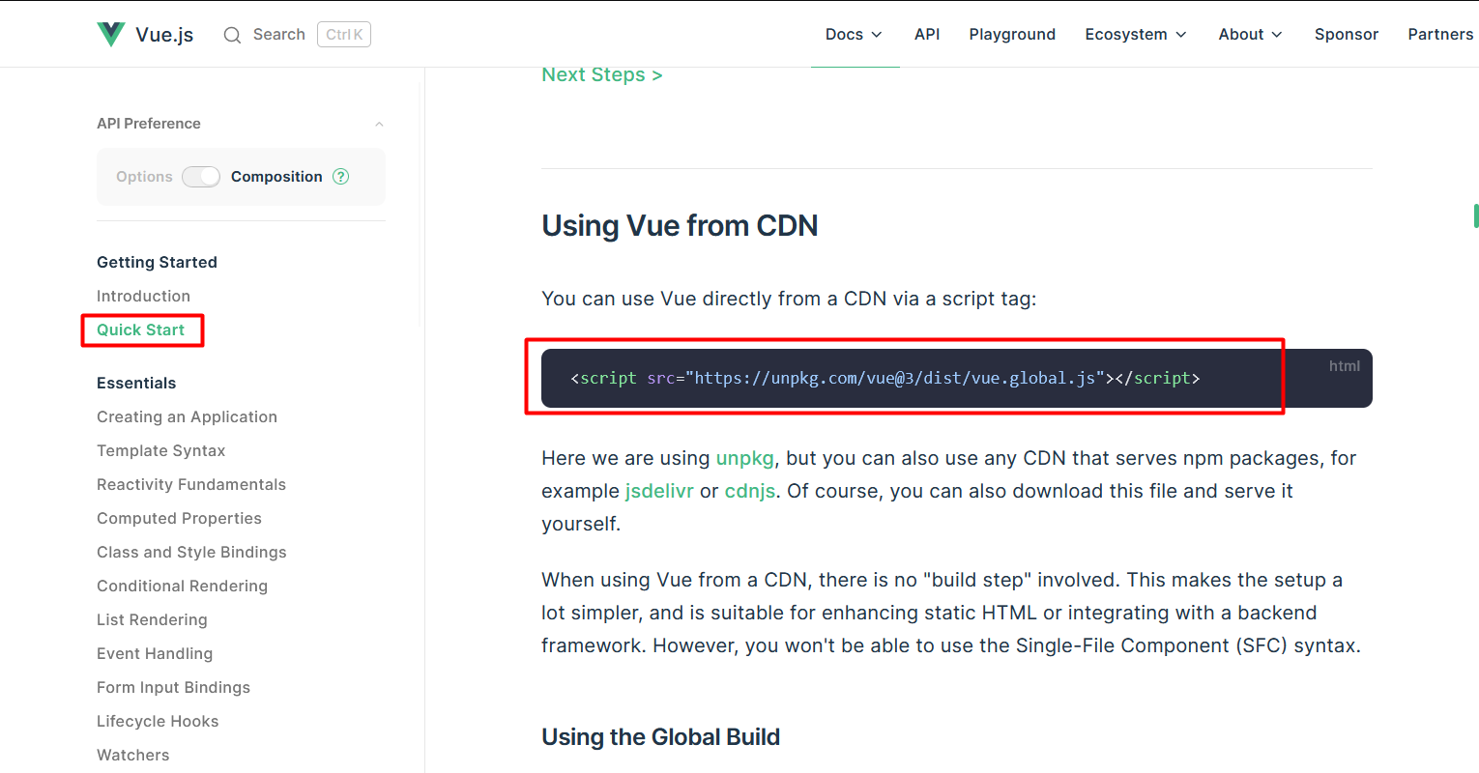
Progressive
Installation With CDN
Vue 3
Quick Start
Installation With CDN
Installation With CLI
Deference Between CDN & CLI
@Programing with Rakib

Slide 2
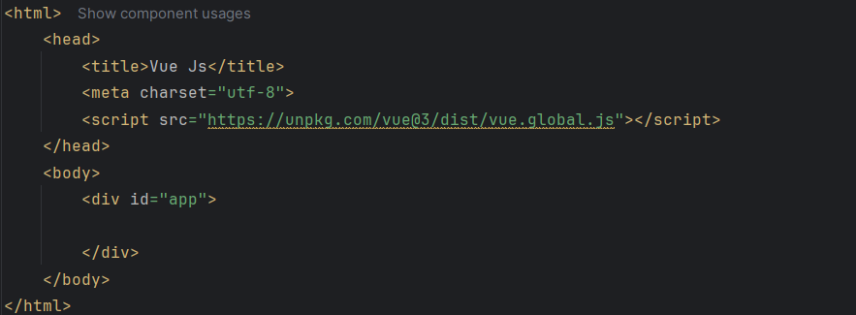
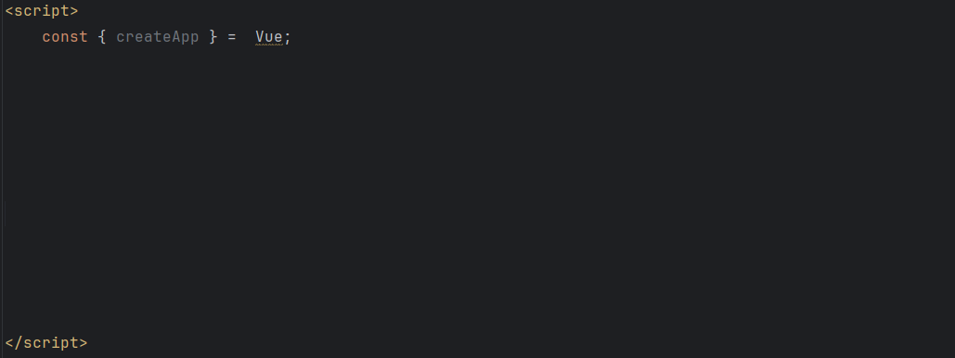
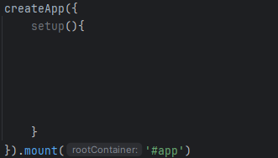

Progressive
Installation With CDN
Vue 3
Quick Start
Installation With CDN
Installation With CLI
Deference Between CDN & CLI
@Programing with Rakib

Slide 3

Progressive
Installation With CDN
Vue 3
Quick Start
Output
Installation With CDN
Installation With CLI
Deference Between CDN & CLI
@Programing with Rakib

Slide 4
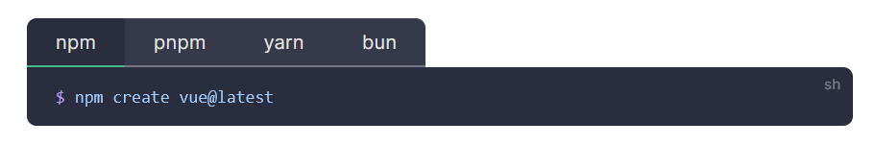
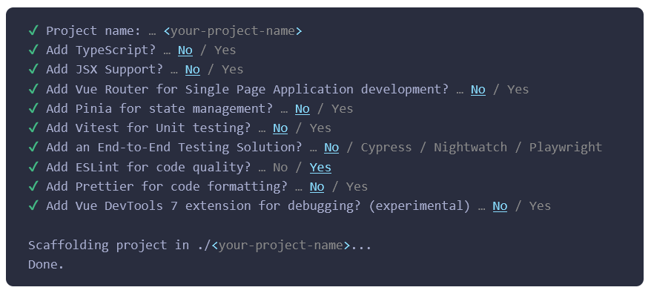
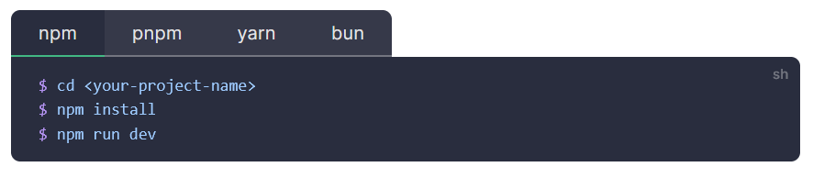
Progressive
Installation With CLI
Vue 3
Quick Start
Installation With CDN
Installation With CLI
Deference Between CDN & CLI
@Programing with Rakib

Slide 5
Progressive
Installation With CLI
Vue 3
Quick Start
Installation With CDN
Installation With CLI
Deference Between CDN & CLI
@Programing with Rakib

Slide 6
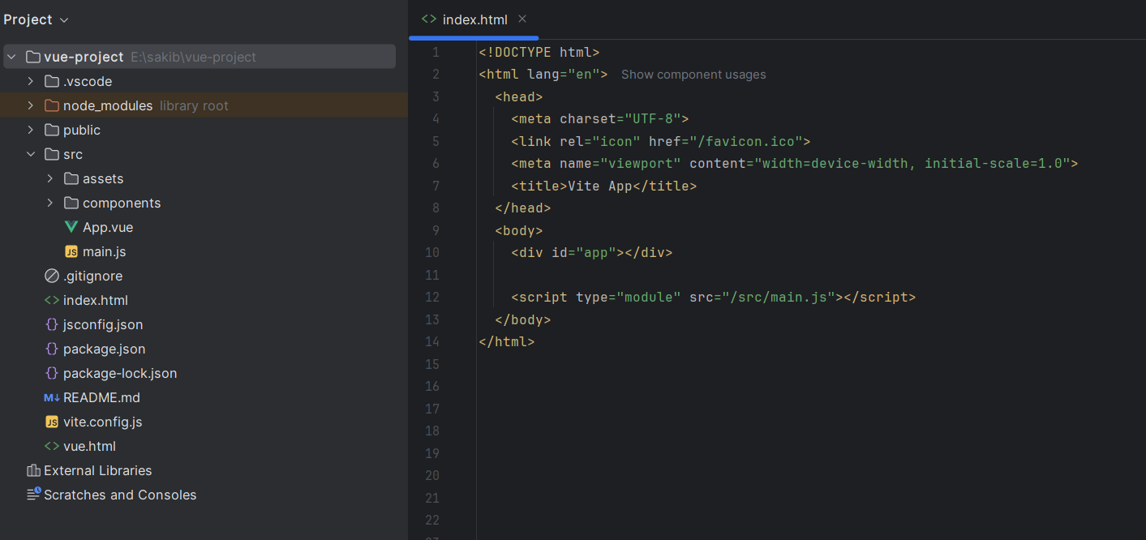
Progressive
Installation With CLI
Vue 3
Quick Start
Installation With CDN
Installation With CLI
Deference Between CDN & CLI
@Programing with Rakib

Slide 7
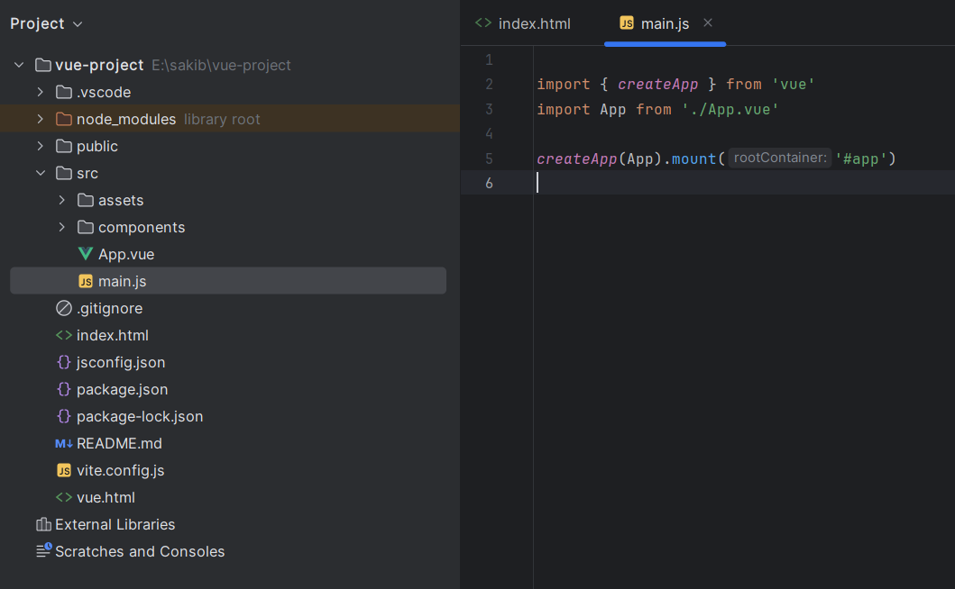
Progressive
Installation With CLI
Vue 3
Quick Start
Installation With CDN
Installation With CLI
Deference Between CDN & CLI
@Programing with Rakib

Slide 8
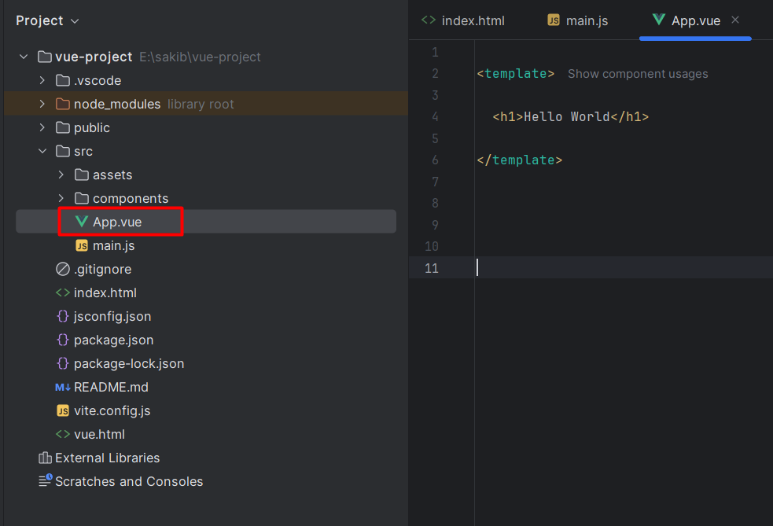
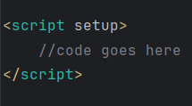
Progressive
Installation With CLI
Vue 3
Quick Start
Installation With CDN
Installation With CLI
Deference Between CDN & CLI
@Programing with Rakib

Slide 9
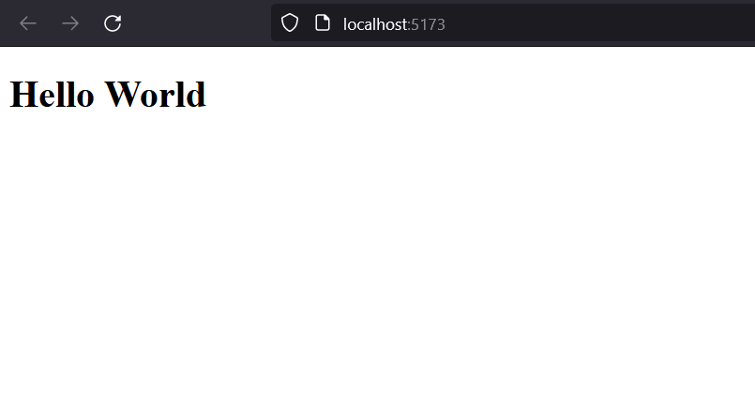
Progressive
Installation With CLI
Vue 3
Quick Start
Output
Installation With CDN
Installation With CLI
Deference Between CDN & CLI
@Programing with Rakib

